Slide 1
CSE 2203: Digital Technique
Sequential Logic Design

Slide 2
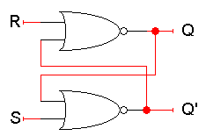
Storing a value: SR = 00
What if S = 0 and R = 0?
The equations on the right reduce to:
Q_{next} = (0 + Q’_{current})’ = Q_{current}
Q’_{next} = (0 + Q_{current})’ = Q’_{current}
So when SR = 00, then Q_{next} = Q_{current}. Whatever value Q has, it keeps.
This is exactly what we need to store values in the latch.
Q_{next} = (R + Q’_{current})’
Q’_{next} = (S + Q_{current})’

Slide 3
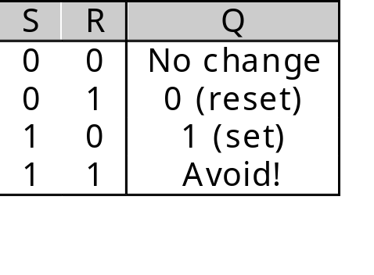
Setting the latch: SR = 10
What if S = 1 and R = 0?
Since S = 1, Q’_{next} is 0, regardless of Q_{current}:
Q’_{next} = (1 + Q_{current})’ = 0
Then, this new value of Q’ goes into the top NOR gate, along with R = 0.
Q_{next} = (0 + 0)’ = 1
So when SR = 10, then Q’_{next} = 0 and Q_{next} = 1.
This is how you set the latch to 1. The S input stands for “set.”
Notice that it can take up to two steps (two gate delays) from the time S becomes 1 to the time Q_{next} becomes 1.
But once Q_{next} becomes 1, the outputs will stop changing. This is a stable state.
Q_{next} = (R + Q’_{current})’
Q’_{next} = (S + Q_{current})’

Slide 4
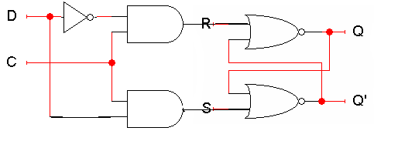
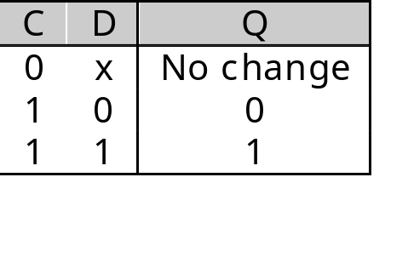
D latch
  When C = 0, so the state Q does not change.
  When C = 1, the latch output Q will equal the input D.

Slide 5
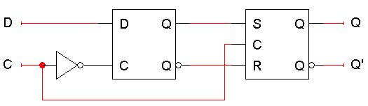
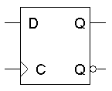
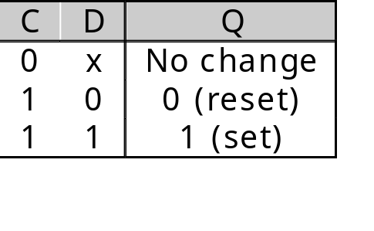
Positive edge triggering
This is called a positive edge-triggered flip-flop.
  The flip-flop output Q changes only after the positive edge of C.
  The change is based on the flip-flop input values that were present right at the positive edge of the clock signal.
The D flip-flop’s behavior is similar to that of a D latch except for the positive edge-triggered nature, which is not explicit in this table.

Slide 6
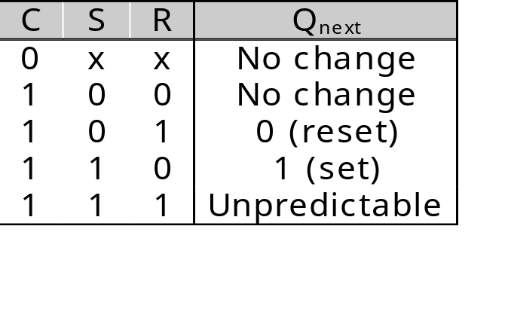
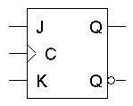
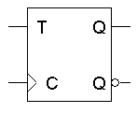
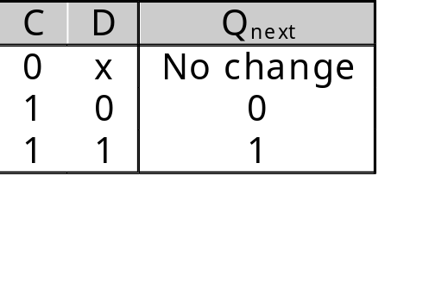
Flip-flops -1
An SR flip-flop. We will try not to use this due to the unpredictability after inputs 11.
A D flip-flop.
S
R
D

Slide 7
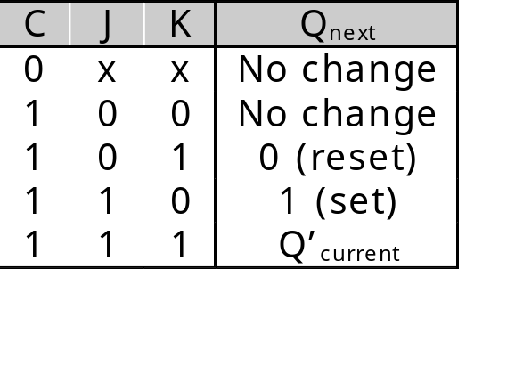
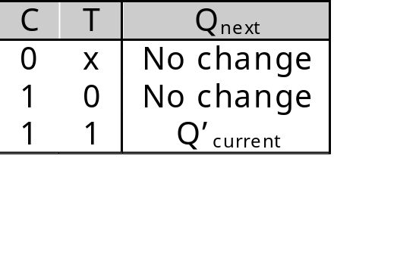
Flip-flops -2
A JK flip-flop has inputs that act like S and R, but the inputs JK=11 are used to complement the flip-flop’s current state.
A T flip-flop can only maintain or complement its current state.

Slide 8
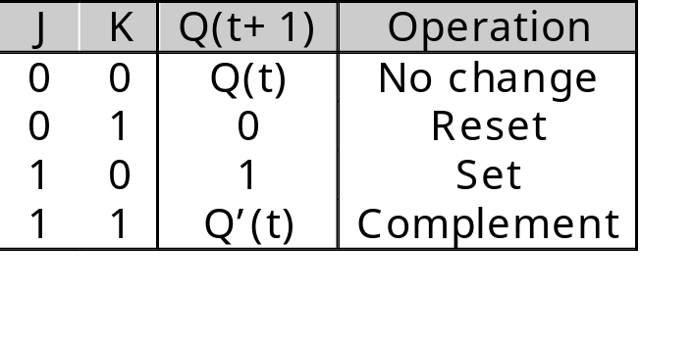
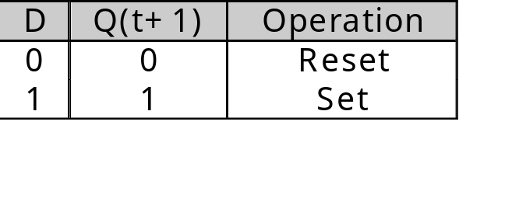
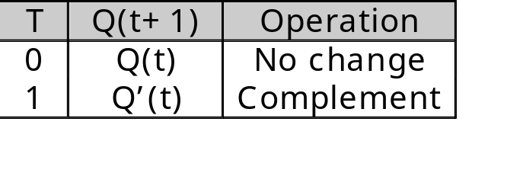
Characteristic tables

Slide 9
Characteristic equations
characteristic equations: the next state Q(t+1) is defined in terms of the current state Q(t) and inputs.
Q(t+1) = D
Q(t+1) = K’Q(t) + JQ’(t)‏
Q(t+1) = T’Q(t) + TQ’(t)‏
= T ⊕ Q(t)‏

Slide 10
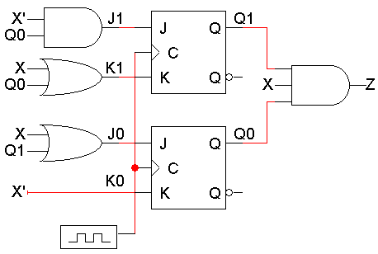
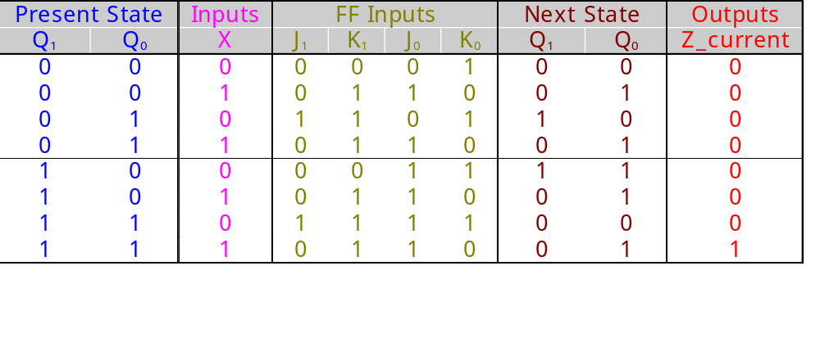
Analysis - 1
J₁ = X’ Q₀
K₁ = X + Q₀
J₀ = X + Q₁
K₀ = X’

Slide 11
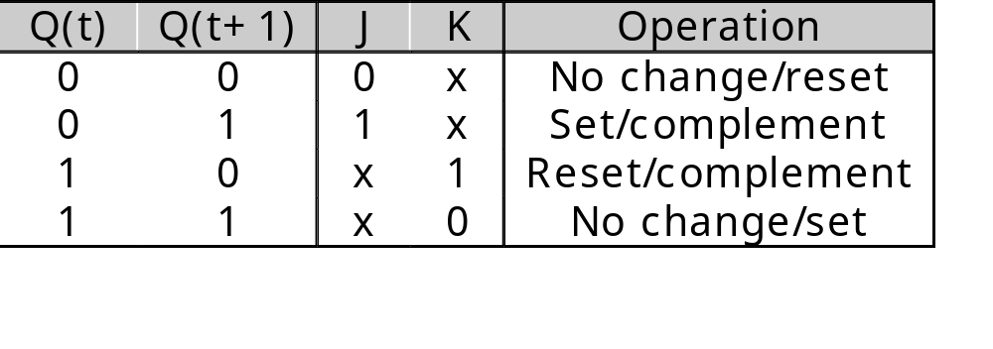
JK excitation table
An excitation table shows what flip-flop inputs are required in order to make a desired state change.
This is the same information that’s given in the characteristic table, but presented “backwards.”

Slide 12
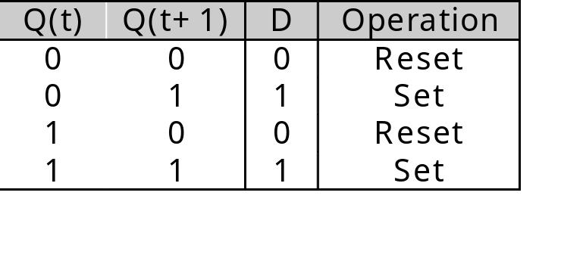
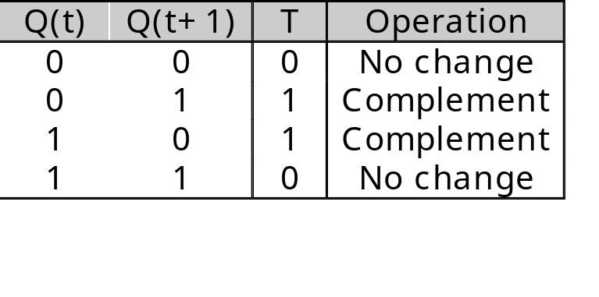
Excitation tables for all flip-flops

Slide 13
Flip-flop comparison
JK flip-flops are good because there are many don’t care values in the flip-flop inputs, which can lead to a simpler circuit.
D flip-flops have the advantage that you don’t have to set up flip-flop inputs at all, since Q(t+1) = D. However, the D input equations are usually more complex than JK input equations
In practice, D flip-flops are used more often.
  There is only one input for each flip-flop, not two.
  There are no excitation tables to worry about.
  D flip-flops can be implemented with slightly less hardware than JK flip-flops.

Slide 14
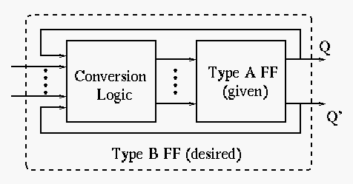
Flip flop Conversion
The purpose is to convert a given type A FF to a desired type B FF using some conversion logic.

Slide 15
Flip flop Conversion
Required 5 Steps.
Available flip-flop, Required flip-flop
Characteristics table
Excitation table
Determine the Boolean expression
Draw the circuit

Slide 16

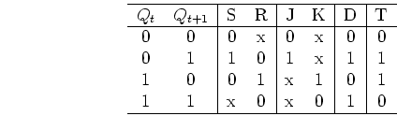
Flip flop Conversion (Cont’d)
The key here is to use the excitation table, which shows the necessary triggering signal (S,R, J,K, D and T) for a desired flip flop state transition :

Slide 17
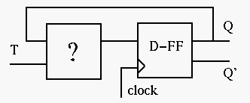

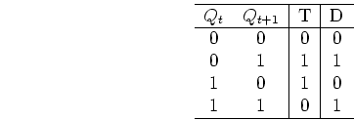
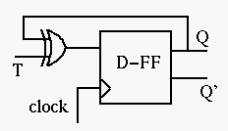
Flip flop Conversion (Cont’d)
Example 1: Convert a D-FF to a T-FF:
We need to design the circuit to generate the triggering signal D as a function of T and Q:
Consider the excitation table:

Slide 18
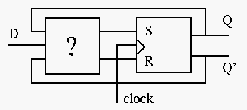
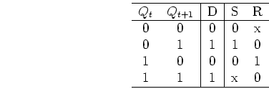
Flip flop Conversion (Cont’d)
Example 2: Convert a RS-FF to a D-FF:
We need to design the circuit to generate the triggering signals S and R as functions of D and Q.
Consider the excitation table:

Slide 19
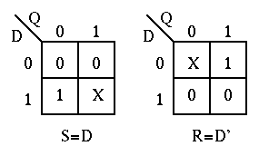
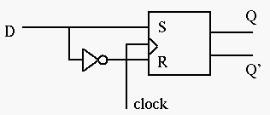
Flip flop Conversion (Cont’d)
Convert a RS-FF to a JK-FF and D-FF to JK-FF (Assignment)

Slide 20
Summary
The basic sequential circuit design procedure:
  Make a state table and, if desired, a state diagram. This step is usually the hardest.
  Assign binary codes to the states if you didn’t already.
  Unused states can be treated as don’t care conditions.
  Use the present states, next states, and flip-flop excitation tables to find the flip-flop input values.
  Write simplified equations for the flip-flop inputs and outputs and build the circuit.
How do we minimize the states to be used?

